Slide 1
Test Case Techniques - BBT

Slide 2
What is Black Box Testing?
Black box testing, which is also known as behavioral, opaque-box, closed-box, specification-based or eye-to-eye testing, is a Software Testing method that analyses the functionality of a software/application without knowing much about the internal structure/design of the item that is being tested and compares the input value with the output value.

Slide 3
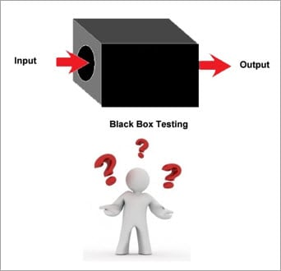
The main focus in black box testing is on the functionality of the system as a whole.
Notes:
The term ‘behavioral testing' is also used for black box testing. Behavioral test design is slightly different from the black-box test design because the use of internal knowledge isn't strictly forbidden, but it's still discouraged.

Slide 4
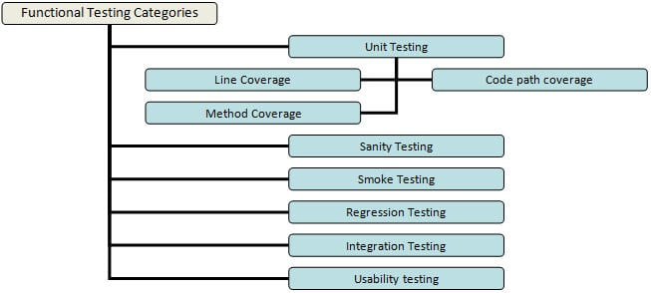
Types of Black Box Testing
1. Functional Testing
Notes:
#1) Functional Testing
This type deals with the functional requirements or specifications of an application. Here, different actions or functions of the system are being tested by providing the input and comparing the actual output with the expected output.
For Example, when we test a Dropdown list, we click on it and verify that it expands and all the expected values are showing in the list.
Smoke Testing: Testing that is done after each build is released to test in order to ensure build stability. It is also called as build verification testing.
Sanity Testing: Testing that is done to ensure that all the major and vital functionalities of the application/system are working correctly. This is generally done after a smoke test.
Integration tests: When the system relies on multiple functional modules that might individually work perfectly, but have to work coherently when clubbed together to achieve an end to end scenario, validation of such scenarios is called Integration testing.
Regression tests: Testing performed to ensure that adding new code, enhancements, fixing of bugs is not breaking the existing functionality or causing any instability and still works according to the specifications.
System testing is a testing that is performed on a complete system to verify if it works as expected once all the modules or components are integrated.
Beta/Usability testing: Product is exposed to the actual customer in a production like an environment and they test the product. The user’s comfort is derived from this and the feedback is taken. This is similar to that of User Acceptance testing.

Slide 5
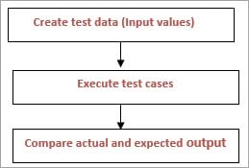
Process

Slide 6

Functional or behavioral testing generates an output based on the given inputs and determines if the System is functioning correctly as per the specifications.

Slide 7
Entry/Exit criteria
Entry criteria:
Requirement Specification document is defined and approved.
Test Cases have been prepared.
Test data has been created.
The environment for testing is ready, all the tools that are required are available and ready.
Complete or partial Application is developed and unit tested and is ready for testing.

Slide 8
Exit Criteria:
Execution of all the functional test cases has been completed.
No critical or P1, P2 bugs are open.
Reported bugs have been acknowledged.

Slide 9
Steps Involved
The very first step involved is to determine the functionality of the product that needs to be tested and it includes testing the main functionalities, error condition, and messages, usability testing i.e. whether the product is user-friendly or not etc.
Next step is to create the input data for the functionality to be tested as per the requirement specification.
Later, from the requirement specification, the output is determined for the functionality under test.
Prepared test cases are executed.
Actual output i.e. the output after executing the test case and expected output (determined from requirement specification) are compared to find whether the functionality is working as expected or not.

Slide 10
Approach
Different kind of scenarios can be thought of and authored in the form of “test cases”.
It mostly has four parts to it:
Test summary
Pre-requisites
Test Steps and
Expected results.

Slide 11
Functional Testing Use Case Examples:
Take an online HRMS portal where the employee logs in with his user account and password. On the login page, there are two text fields for the username & password, and two buttons: Login and Cancel. Successful login takes the user to the HRMS home page and cancel will cancel the login.

Slide 12
Specifications are as shown below
#1 ) The user id field takes a minimum of 6 characters, a maximum of 10 characters, numbers(0-9), letters(a-z, A-z), special characters (only underscore, period, hyphen allowed) and it cannot be left blank. User id must begin with a character or a number and not special characters.
#2) Password field takes a minimum of 6 characters, a maximum of 8 characters, numbers (0-9), letters (a-z, A-Z), special characters (all) and cannot be blank.

Slide 13
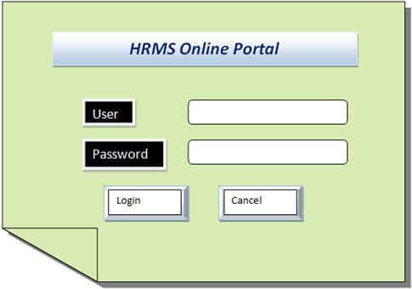

Slide 14
The basic approach to testing this scenario can be classified into two broad categories:
Positive testing and
Negative testing
Positive tests are happy path tests which are done to ensure that the product means – at least the basic requirements that are vital to the customer usage.
Negative scenarios ensure that the product behaves properly even when it is subjected to unexpected data.

Slide 15
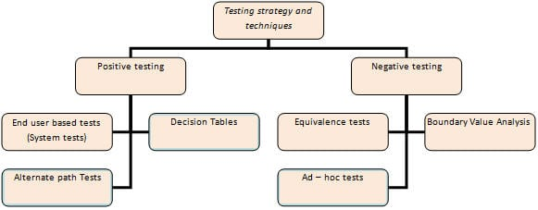
Functional Testing Techniques

Slide 16
#1) End-user based/System Tests
In the Example, a customer scenario would include tasks like HRMS application loading, entering the correct credentials, going to the home page, performing some actions and logging out of the system. This particular flow has to work without any errors for a basic business scenario.

Slide 17
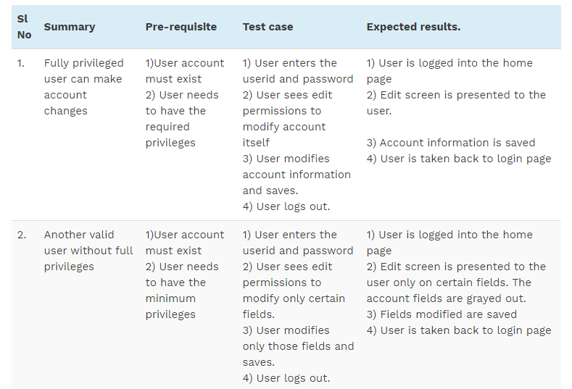

Slide 18
#2) Equivalence Tests
In Equivalence partitioning, the test data are segregated into various partitions called equivalence data classes.
Data in each partition must behave in the same way, therefore only one condition needs to be tested. Similarly, if one condition in a partition doesn’t work, then none of the others will work.
For Example, in the above scenario the user id field can have a maximum of 10 characters, so entering data > 10 should behave the same way.

Slide 19
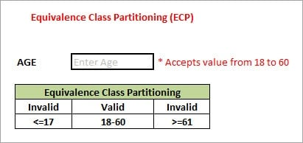
Equivalence Partitioning
Notes:
This technique is also known as Equivalence Class Partitioning (ECP). In this technique, input values to the system or application are divided into different classes or groups based on its similarity in the outcome.
Hence, instead of using each and every input value we can now use any one value from the group/class to test the outcome. In this way, we can maintain the test coverage while we can reduce a lot of rework and most importantly the time spent.
Two invalid classes will be:
a) Less than or equal to 17.
b) Greater than or equal to 61.
One valid class will be anything between 18 to 60.

Slide 20
#3) Boundary Value Tests
Boundary tests imply data limits to the application and validate how it behaves.
Therefore, if the inputs are supplied beyond the boundary values, then it is considered to be a negative testing. So a minimum of 6 characters for the user sets the boundary limit. Tests written to have user id < 6 characters are boundary analysis tests.

Slide 21
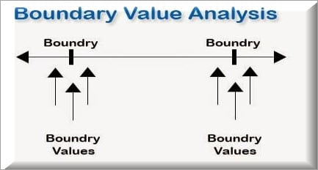
Notes:
From the name itself, we can understand that in this technique we focus on the values at boundaries as it is found that many applications have a high amount of issues on the boundaries.
Boundary means the values near the limit where the behavior of the system changes. In boundary value analysis both the valid inputs and invalid inputs are being tested to verify the issues.
If we want to test a field where values from 1 to 100 should be accepted then we choose the boundary values: 1-1, 1, 1+1, 100-1, 100, and 100+1. Instead of using all the values from 1 to 100, we just use 0, 1, 2, 99, 100, and 101.

Slide 22
#4) Decision-based Tests
Decision-based tests are centered around the ideology of the possible outcomes of the system when a particular condition is met.
If the wrong credentials are entered, it should indicate that to the user and reload the login page.
If the user enters the correct credentials, it should take the user to the next UI.
If the user enters the correct credentials but wishes to cancel login, then it should not take the user to the next UI and reload the login page.

Slide 23
If { (Condition = True) then action1 ; } else action2; /*(condition = False)*/
Notes:
Then a tester will identify two outputs (action1 and action2) for two conditions (True and False). So based on the probable scenarios a Decision table is carved to prepare a set of test cases.

Slide 24
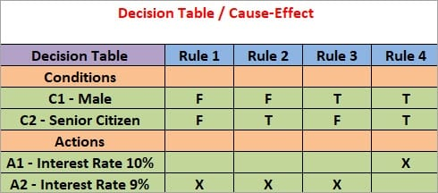
Take an example of XYZ bank that provides interest rate for the Male senior citizen as 10% and for rest of the people 9%.

Slide 25
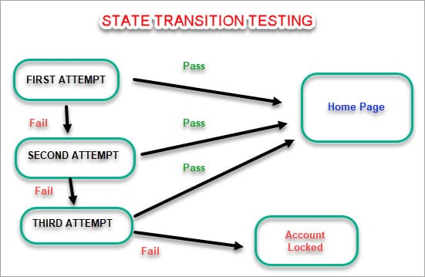
#5) State Transition Testing
Notes:
State Transition Testing is a technique that is used to test the different states of the system under test. The state of the system changes depending upon the conditions or events. The events trigger states which become scenarios and a tester needs to test them.
A systematic state transition diagram gives a clear view of the state changes but it is effective for simpler applications. More complex projects may lead to more complex transition diagrams thus making it less effective.

Slide 26
#6) Alternate Flow Tests
Alternate path tests are basically run to validate all the possible ways that exist, other than the main flow to accomplish a function

Slide 27
#7) Ad-hoc Tests
When most of the bugs are uncovered through the above techniques, ad-hoc tests are a great way to uncover any discrepancies that are not observed earlier.
These are performed with the mindset of breaking the system and see if it responds gracefully

Slide 28
For Example, a sample test case would be:
A user is logged in, but the admin deletes the user account while he is performing some operations. It would be interesting to see how the application handles this gracefully.

Slide 29
#8) Error Guessing:
Divide by zero.
Handling null values in text fields.
Accepting the Submit button without any value.
File upload without attachment.
File upload with less than or more than the limit size.
Notes:
This is a classic example of experience based testing.
In this technique, the tester can use his/her experience about the application behavior and functionalities to guess the error-prone areas. Many defects can be found using error guessing where most of the developers usually make mistakes.
Divide by zero.
Handling null values in text fields.
Accepting the Submit button without any value.
File upload without attachment.
File upload with less than or more than the limit size.

Slide 30
#9) Graph-Based Testing Methods:
Each and every application is build up of some objects. All such objects are identified and the graph is prepared. From this object graph, each object relationship is identified and test cases are written accordingly to discover the errors.

Slide 31
#10) Comparison Testing
Different independent versions of the same software are used to compare to each other for testing in this method.

Slide 32
How to do Step-wise?
The foremost step is to understand the Requirement specification of an application. A proper documented SRS(Software Requirement Specification) should be in place.
Using the above mentioned black box testing techniques such as Boundary value analysis, Equivalence partitioning etc sets of valid and invalid inputs are identified with their desired outputs and test cases are designed based on that.
The designed test cases are executed to check if they Pass or Fail by verifying the actual results with the expected results.
The Failed test cases are raised as Defects/Bugs and addressed to the development team to get it Fixed.
Further based on the defects being fixed, the tester Retests the defects to verify if it is recurring or not.

Slide 33
2. Non-Functional Testing
Apart from the functionalities of the requirements, there are several non-functional aspects as well that are required to be tested to improve the quality and performance of the application.

Slide 34
Few major types of Non-functional testing include:
Usability Testing
Load Testing
Performance Testing
Compatibility Testing
Stress Testing
Scalability Testing

Slide 35
What is Non-Functional Testing?
Non-functional testing is done to verify the non-functional requirement of the application like Performance, Usability etc.
It verifies if the behavior of the system is as per the requirement or not. It covers all the aspects which are not covered in functional testing.
Notes:
The clients are also interested in fulfilling the functional requirements which are directly related to the functionality of an application. But in the actual phase i.e. when you’re functionally tested, the software comes into the market and is used by the real end users, and there are chances for it to face some issues related to the performance.
These issues are not related to the functionality of the system, but they can affect the user experience in a negative manner. Hence it is important for the software or application to be tested for Non-Functional requirements as well in order to avoid negative customer experience.

Slide 36
How does the application perform under normal circumstances?
How does the application behave when too many users log in concurrently?
Can the application handle stress?
How secure is the application?
Can the application recover from any disaster?
Can the application behave in the same way in a different environment or OS?
How easy is to port the application in a different system?
Are the documents/user manual provided with the application easy to understand

Slide 37
Purpose
The sole purpose of this type of testing is to ensure that the non-functional aspects of the application are tested and the application works well in context to the same.
The purpose is to cover the testing of all the characteristics of the application which help to provide an application that meets the business expectation.

Slide 38
Advantages
It covers the testing which cannot be covered in functional testing.
It ensures that the application runs efficiently and is reliable enough.
It ensures the security of the application.

Slide 39
How to Capture Non-Functional Requirements?
Non-Functional requirements are used to perform Non-Functional testing.
These requirements include the performance output that is expected from the application or the software under test. This basically includes the time taken by the software to operate a particular system

Slide 40
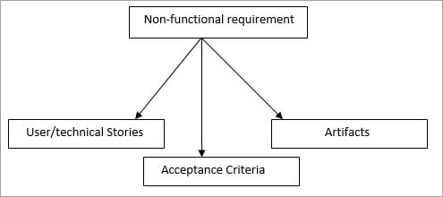
A non-functional requirement should be captured as
User /Technical Stories
In Acceptance criteria
In Artifact

Slide 41
#1) User /Technical Stories
A non-functional requirement can be captured using user stories or technical stories.
Capturing Non-functional requirements as a user story is same as that of capturing any other requirement. The only difference in the user and a technical story is that the user story requires discussion and has visibility

Slide 42
#2) Acceptance Criteria
Acceptance Criteria is the point that is defined for accepting the product by the customer i.e. to get the product accepted to the defined points should be in pass state.
Notes:
A non-functional requirement should be included in the acceptance criteria but sometimes it’s not possible to test the non-functional requirements with every story i.e. with every iteration. Hence, the requirements should be added or tested with the relevant iteration only.

Slide 43
#3) In Artifacts
A separate artifact should be prepared for the non-functional requirements, this in turn would help to have a better idea of what needs to be tested and how it can be done in iterations.

Slide 44
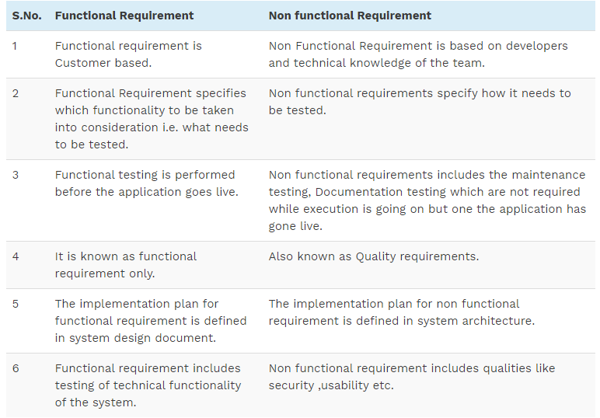
Difference in Functional & Non Functional Requirements

Slide 45
I is This Black Box or White Box Testing?
The non-functional test comes under a black box testing technique.

Slide 46
Checklist for Performance Testing
The response time of the application should be verified i.e. how long does it take to load the application, any input given to the application provides the output in how much time, refreshing the browser etc.
Throughput should be verified for the number of transactions completed during a load test.
Environment set up should be the same as the live environment or else the results would not be the same.
Process time – Process activities like import & export of excel, any calculations in the application should be tested.
Interoperability should be verified i.e. a software should be able to inter-operate with the other software’s or systems.
ETL time should be verified i.e. the time taken in extracting, transforming and loading the data from one database to another.
Increasing Load on the application should be verified.

Slide 47
Checklist for Security testing
Authentication: Only an authentic user should be able to Log in.
Authorized: User should be able to log into those modules only for which he is authorized or for which the user has been provided access to.
Password: Password requirement should be verified i.e. password should be as per how the requirement defines i.e. length, special characters, numbers etc.
Timeout: If the application is inactive, then it should timeout in a specified time.
Data Backup: Data backup should be taken at a specified time and should be copied to a secured location.
Internal links to the web application should not be accessible if placed directly in the browser.
All communication should be encrypted.

Slide 48
Checklist for Documentation Testing
User & System documentation.
Documents for training purpose.

Slide 49
Approach Document
Develop a specific approach document for the Performance Test stage by refining the overall Test strategy. This Test approach guides in planning and execution of all the Performance Test tasks.
Test Scope
Test Metrics
Test Tools
Key Dates and Deliverables

Slide 50
T Test Scope
Conduct Performance Testing from different perspectives, such as user performance, business processes, system stability, resource consumption, and so on. Types of Performance Testing to execute are discussed in the above section of the article (like Load test, Stress test etc.)

Slide 51
Test Metrics
The Test approach refines the metrics to measure and report during Testing, such as:
Response time (online)
Batch window (batch)
Throughput (For Example, number of transactions per unit of time)
Utilization (For Example, the percentage of resources utilized)

Slide 52
Test Tools
Load generation tools
Performance monitoring tools
Performance analysis tools
Application profiling tools
Base-lining tools.

Slide 53
Key Dates and Deliverables
Date and time of each Performance Test conduct.
Types of tests and functionality mix to be included in each Performance Test conduct.
Performance Test completion dates.

Slide 54
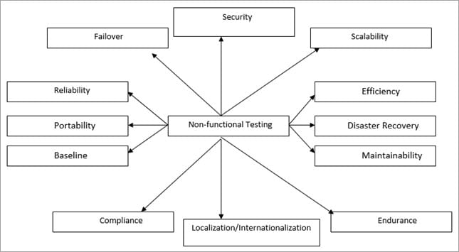
Non-Functional Testing Types

Slide 55
Performance Testing
Validates that the system meets the expected response time.
Evaluates that the significant elements of the application meet the desired response time.
It can also be conducted as a part of integration testing and system testing.

Slide 56
Load Testing
Validates that the system performs as expected when concurrent users access the application and get the expected response time.
This test is repeated with multiple users to get the response time and throughput.
At the time of testing, the database should be realistic.
The test should be conducted on a dedicated server which stimulates the actual environment.

Slide 57
Stress Testing
Test on low memory or low disc space on clients/servers that reveal the defects which cannot be found under normal conditions.
Multiple users perform the same transactions on the same data.
Multiple clients are connected to the servers with different workloads.
Reduce the Think Time to “Zero” to stress the servers to their maximum stress

Slide 58
Volume Testing
When the software is subject to large amounts of data, checks the limit where the software fails.
Maximum database size is created and multiple clients query the database or create a larger report.
Example– If the application is processing the database to create a report, a volume test would be to use a large result set and check if the report is printed correctly.

Slide 59
Usability Testing
Is the output correct and meaningful and is it the same as which was expected as per the business?
Are the errors diagnosed correctly?
Is the GUI correct and consistent with the standard?
Is the application easy for use?

Slide 60
User Interface Testing
GUI should provide help and tool tips to make it easy for use.
Consistent for its look?
Data is traversed correctly from one page to another?
GUI should not annoy the user or get difficult to understand

Slide 61
Compatibility Testing
Test each hardware with minimum and maximum configuration.
Test with different browsers. Test cases are the same as those that were executed during functional testing.
In case the number of hardware and software are too many, then we can use OATS techniques to arrive at the test cases to have maximum coverage.
Notes:
OATS (Orthogonal array testing technique)
1.Identify the independent variables. These will be referred to as “Factors” 2. Identify the values which each variable will take. These will be referred as “Levels” 3. Search for an orthogonal array that has all the factors from step 1 and all the levels from step 2 4. Map the factors and levels with your requirement 5. Translate them into the suitable test cases 6. Look out for the left over or special test cases (if any)

Slide 62
Recovery Testing
Power interruption, to the client while doing CURD activities.
Invalid database-pointers and keys.
Database process is aborted or prematurely terminated.
Database pointers, fields and keys are corrupted manually and directly within the database.
Physically disconnect the communication, power turn off, turn down the routers and network servers.

Slide 63
Instability Testing
Validates that the system components are installed correctly on the designated hardware.
Validates that the navigation on the new machine updates the existing installation and older versions.
Validates that with insufficient disc space, there is no unacceptable behavior.

Slide 64
Documentation Testing
Validates that the stated documents are available in the product.
Validates all the user guides, set up instructions, read me files, release notes and online help.

Slide 65
Failover Testing
Failover testing is done in order to verify that in case of a system failure the system is capable enough to handle extra resources like servers.

Slide 66
Security Testing
Security testing is done to ensure that the application has no loopholes which could lead to any data loss or threats. It is one of the important aspects of non-functional testing and if not performed properly, it can lead to security threats.
It includes testing authentication, authorization, integrity, and availability.

Slide 67
Scalability Testing
Scalability testing is done to verify if the application is capable enough to handle increased traffic, number of transactions, data volume etc.
The system should work as expected when the volume of data or change in the size of data is done.

Slide 68
Compliance Testing
Compliance testing is done to verify if the standards defined are being followed or not. Audits are done to verify the same.
For Example, Audits are done to verify the process of creating test cases/test plans and placing them in the shared location with the standard name that is being done or not. In QC, while naming the test cases the standard test case name is being followed or not. Documentation is complete and approved or not.

